Slide 1
Application of data science methodologies to explore, predict and model wellbeing outcomes using the New Zealand Integrated Data Infrastructure (IDI).
Presenters:
Anantha Narayanan T L
Tom Stewart
Scott Duncan

Slide 2
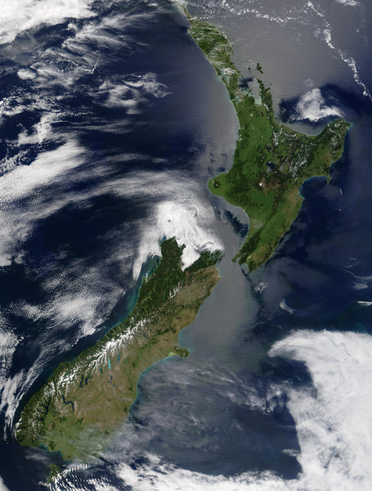









WELLBEING IS IMPORTANT
National
Regional
How is wellbeing measured in NZ?
“Health is a state of complete physical, mental and social wellbeing and not merely the absence of disease or infirmity” - World Health Organisation
Family
Individual

Slide 3
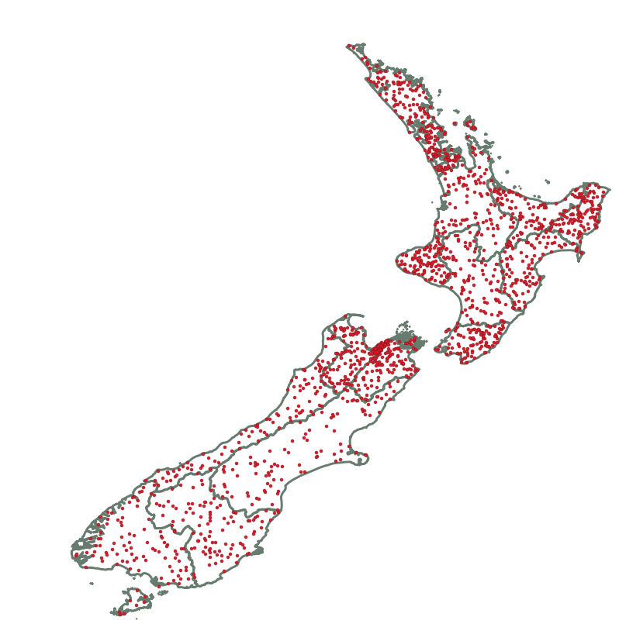
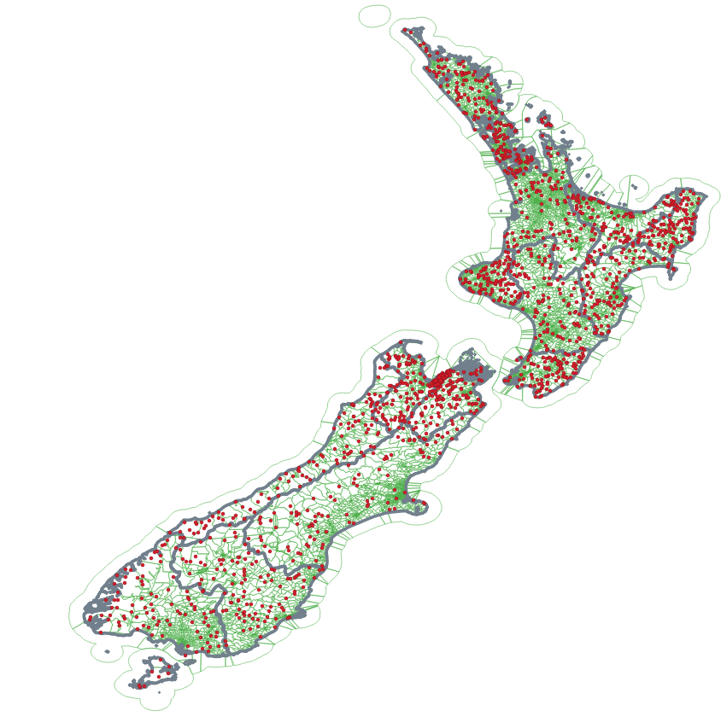
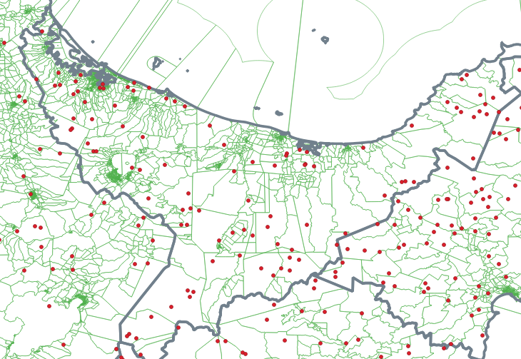
General Social Survey (GSS)
~ 8000 - 10000 individuals/households
Living Standards Framework
Health
Housing
Environment quality
Income and consumption
Jobs and earnings
Time use
Knowledge and skills
Subjective Wellbeing
Safety and security
Social connections
Cultural identity
Civic engagement and governance
meshblock – smallest geographical unit

Slide 4
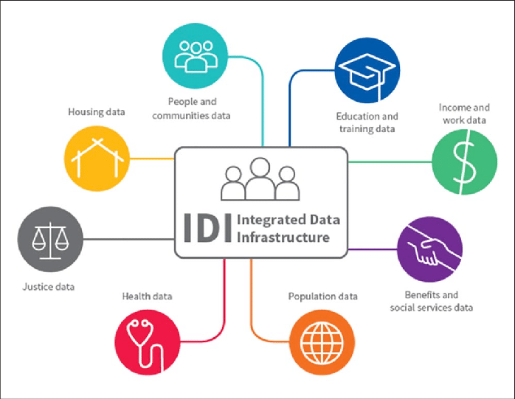
Administrative variables from the IDI
GSS
Ground truth wellbeing measure
Linked using UID
Wellbeing outcomes
Machine learning model (e.g., random forest, neural networks)
For more information, please email:
anantha.narayanan.tl@aut.ac.nz

